Slide 1
Classification of Arrhythmia by Using Deep Learning with 2-D ECG Spectral Image Representation
Project Guide :
Mr. K. AZARUDEEN B.E,M.E
Team id: PNT2022TMID23017
Team Members:
LAKSHMAN RAJ S
BHARATH P
HARISH SRINIVAS M D
KAMALESHWARAN S

Slide 2
Problem Definition:
According to the World Health Organization (WHO), cardiovascular diseases (CVDs) are the number one cause of death today. Over 17.7 million people died from CVDs in the year 2017 all over the world which is about 31% of all deaths, and over 75% of these deaths occur in low and middle-income countries.
Arrhythmia is a representative type of CVD that refers to any irregular change from the normal heart rhythms. There are several types of arrhythmia, although a single arrhythmia heartbeat may not have a serious impact on life, continuous arrhythmia beats can result in fatal circumstances.
.

Slide 3
In this project, we build an effective electrocardiogram (ECG) arrhythmia classification method using a convolutional neural network (CNN), in which we classify ECG into seven categories, one being normal and the other six being different types of arrhythmia using deep two-dimensional CNN with grayscale ECG images.
We are creating a web application where the user selects the image which is to be classified. The image is fed into the model that is trained and the cited class will be displayed on the webpage

Slide 4
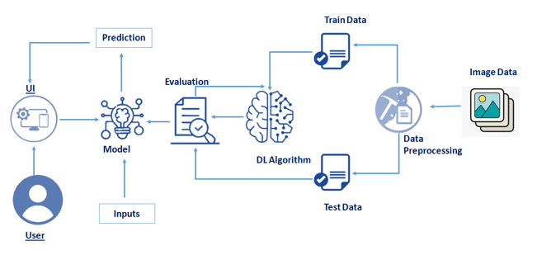
Technical Architecture:

Slide 5
SURVEY PAPERS
1)
Paper title : "Analysis of ECG Signal and Classification of Arrhythmia,".
Authors : H. S. Bhanu, S. Tejaswini, M. S. Sahana, K. Bhargavi, K. S. Praveena and S. S. Jayanna.
Published in: 5th International Conference on Electrical, Electronics, Communication, Computer Technologies and Optimization Techniques (ICEECCOT)
Published on : 16 February 2022
Publication website : https://ieeexplore.ieee.org/stamp/stamp.jsp?tp=&arnumber=9708036&isnumber=9707891

Slide 6
Critical Findings:
For diagnosing cardiac diseases interpretation of ECG signal is very important.
A systematic method of analyzing and interpretation of heart diseases have described in this paper.
In the proposed method features and duration of ECG signals were extracted such as QRS complex, R-R intervals from the noisy signals using Pan Tompkins Algorithm.
The data used for analysis were collected from MIT-BIH arrhythmia database.
Extracted features were estimated with the standard set of values based on the developed decision making algorithm to find the degree and types of arrhythmia.
Finally according to extracted features arrhythmia classified into Bradycardia and Tachycardia.
Paper concluded with evaluating the algorithm by obtaining the detailed results.
Proposed algorithm is simple to adopt with less computation time and high accuracy.

Slide 7
SURVEY PAPERS
2)
Paper title : "An algorithm for detection of arrhythmia".
Authors :Mujeeb Rahman, Mohamed Nasor.
Published in: International Journal of Biological Engineering
Published on : 2011/02/01
Publication website : https://www.researchgate.net/publication/251998423_An_algorithm_for_detection_of_arrhythmia

Slide 8
Critical Findings:
The paper presents an algorithm for Electrocardiogram (ECG) analysis to detect and classify ECG waveform anomalies and abnormalities.
This is achieved by extracting various features and durations of the ECG waveform such as RR interval, QRS complex, P wave and PR durations.
These durations are then compared with normal values to determine the degree and types of abnormalities.
The paper is concluded with detailed results obtained from testing the algorithm using the ECG data.

Slide 9
SURVEY PAPERS
3)
Paper title : "Matlab Based GUI for ECG Arrhythmia Detection Using Pan-Tompkin Algorithm,“
Authors : B. Jindal, Saudagar, Ekta and R. Devi
Published in: 2018 Fifth International Conference on Parallel, Distributed and Grid Computing (PDGC)
Published on : 27 June 2019
Publication website : :https://ieeexplore.ieee.org/stamp/stamp.jsp?tp=&arnumber=8745865&isnumber=8745714

Slide 10
Critical Findings:
The purpose of paper is to detect heart arrhythmia which is generated due to irregular heart rhythm.
Graphical user interface (GUI) has been developed for the detection of arrhythmia using Pan-Tompkins algorithm.
Modification has been done in the Pan-Tompkins algorithm for the detection of abnormalities related to heart by calculating various parameters.
This toolbox is developed in MATLAB software. Developed GUI is an efficient and effective way to diagnose heart diseases.

Slide 11
SURVEY PAPERS
4)
Paper title : "An efficient neural network-based method for patient-specific information involved arrhythmia detection,“
Authors :Yunqing Liu, Chengjin Qin, Jinlei Liu, Yanrui Jin, Zhiyuan Li, Chengliang Liu,
Published in: Knowledge-Based Systems,Volume 250
Published on : 17 May 2022
Publication website : https://www.sciencedirect.com/science/article/pii/S0950705122004993

Slide 12
Critical Findings:
In this project, An inverted residual block-embedded deep neural network (IRBEDNN) is proposed to accurately detect arrhythmias based on processed ECGs.
Results show that the proposed IRBEDNN-based method achieves good generalization ability with promising accuracy on both the MIT-BIH arrhythmia database and the INCARTDB.
Therefore, the proposed IRBEDNN could accurately and efficiently detect arrhythmias and has positive significance to clinical applications.

Slide 13
SURVEY PAPERS
5)
Paper title : "ECG-based heartbeat classification for arrhythmia detection: A survey,“
Authors :Eduardo José da S. Luz, William Robson Schwartz, Guillermo Cámara-Chávez, David Menotti.
Published in:Computer Methods and Programs in Biomedicine,Volume 127
Published on : 13 December 2015
Publication website https://www.sciencedirect.com/science/article/pii/S0169260715003314

Slide 14
Critical Findings:
In this work, the survey the current state-of-the-art methods of ECG-based automated abnormalities heartbeat classification by presenting the ECG signal preprocessing, the heartbeat segmentation techniques, the feature description methods and the learning algorithms used.
In addition, some of the databases used for evaluation of methods indicated by a well-known standard developed by the Association for the Advancement of Medical Instrumentation (AAMI) and described in ANSI/AAMI EC57:1998/(R)2008 (ANSI/AAMI, 2008).
Finally, limitations and drawbacks of the methods in the literature presenting concluding remarks and future challenges.

Slide 15
THANK YOU

